Slide 1
AGM RMS Association Update Shea O’Neill – Acting Chair

Slide 2
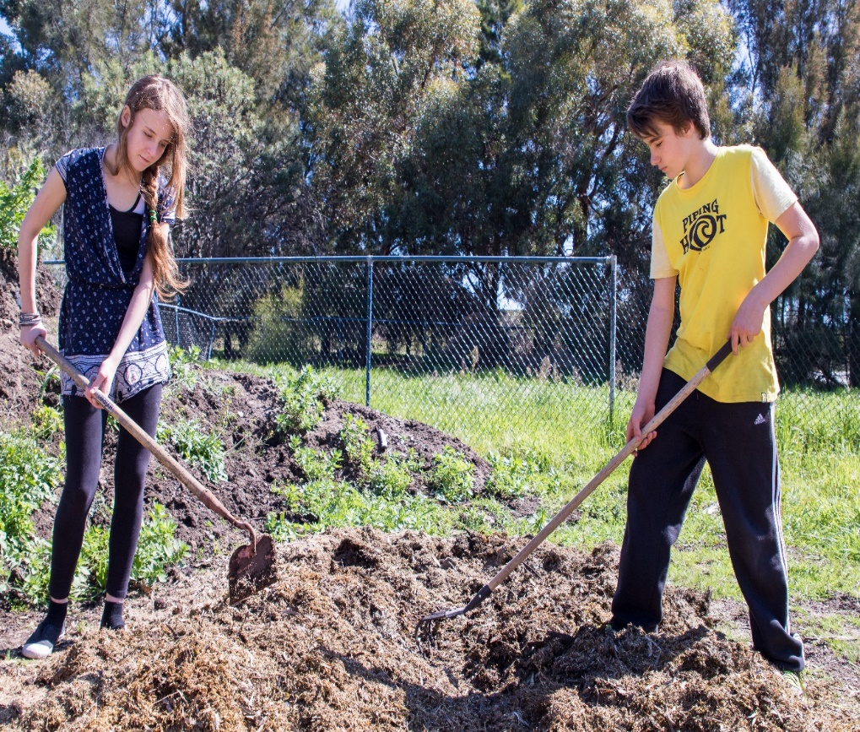
Discussion Points
Governance and Operations – Roles of Board and Principal
Operations Updates – 2017 and 2018 Updates
Parent and Staff Feedback – Brief updates
Board Updates – General updates on Karnup
Open Feedback – Comments and questions

Slide 3
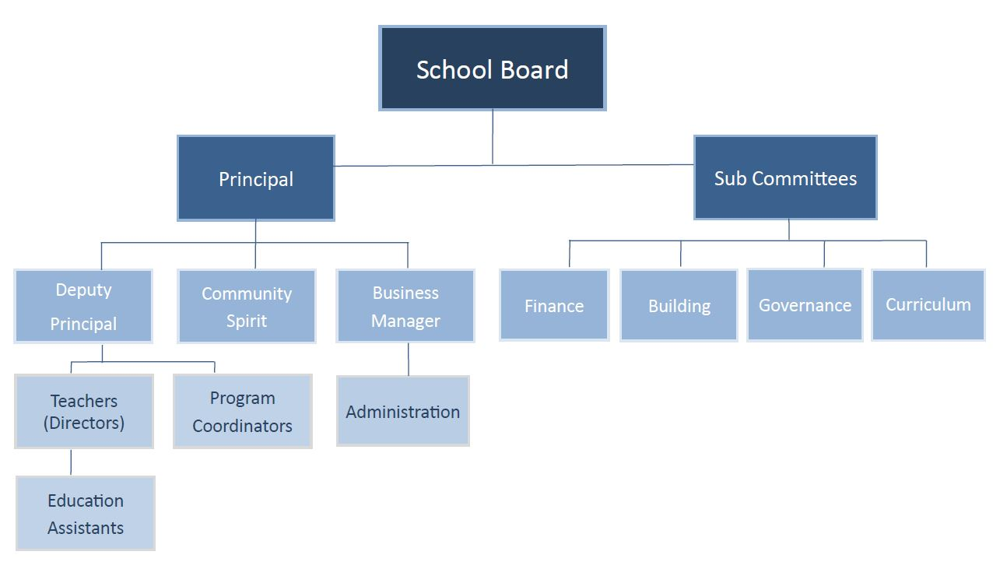
Governance and Operations
Governance, Operations and the sub-committees

Slide 4
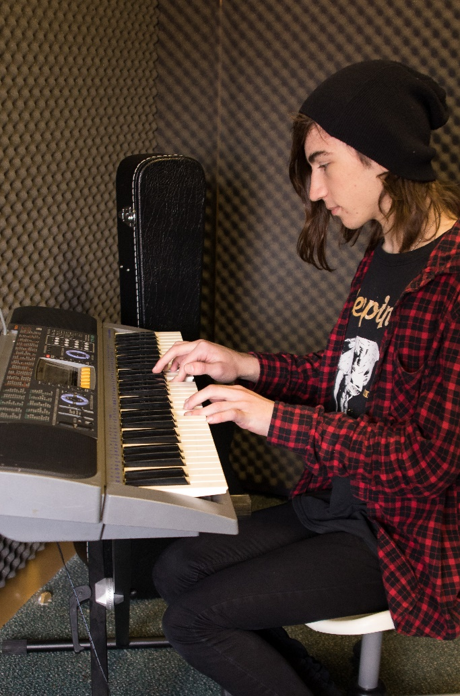
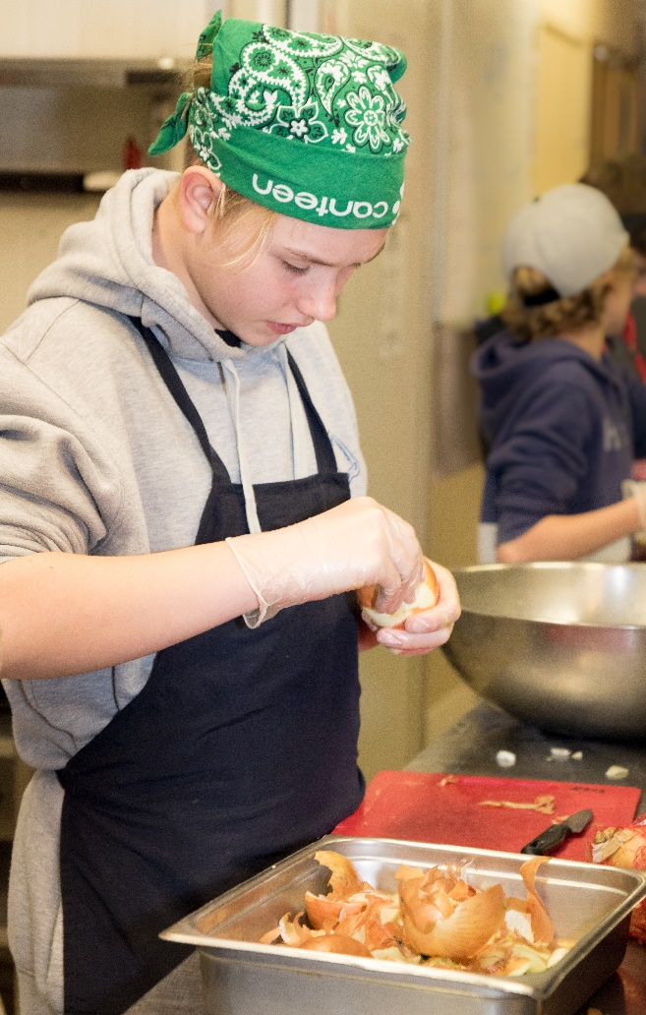
Operational Updates

Slide 5
2017/2018 Highlights
2017 saw further growth in student numbers across all classes in the school and particularly into Upper Primary as a result of increased retention.
Employment of a second full time Upper Primary teacher and the Dugongs class was split on paper into two classes where we saw the reestablishment of the Turtles class.
Wall dividing staff room, exit passage and Dugongs classroom removed and a kitchen installed to create a second Upper Primary classroom.
External roller blinds installed on veranda and rubber matting laid to create an outdoor environment that the Upper Primary classes could utilise.
The primary school music room transformed into staff room complete with a new kitchen and outdoor alfresco area
Parking area line marking for a variety of sports and purchase of moveable basketball rings to provide additional play space for primary children.
Water play area installed in Children’s House outdoor environment and curbing installed to contain soft fall mulch.
New Children’s House sheds installed.

Slide 6
2017/18 Highlights continued
Adolescent Program relocated to third floor at Murdoch University to provide additional space for the growing program.
Extensive renovations undertaken, furniture and materials purchased, five advisory groups established, two in Senior School and three in Middle School and a Deputy Principal position was created.
Negotiations with Salvation Army to lease house at the front of Baldivis property and Infant Toddler Program relocated to this venue along with the Adolescent Programs hospitality, horticulture, woodwork and metalwork programs.
Communications remained a focus with introduction of a marketing personal.
Marketing plan established, introduction of SeeSaw app, upgrade of newsletter format and ‘What’s on this Week’ email.
Family Zone introduced in Upper Primary and Adolescent Programs enabling families to utilise this cyber safety service at home, along with providing the school greater adaptability to programs accessed during school times by students.

Slide 7
2017/18 Highlights continued
Approval from SCSA to deliver Montessori National Curriculum and to report against this for children aged three to fifteen years.
RMS staff worked collaboratively with other WA Montessori schools to map the Montessori National Curriculum to both the Western Australian and the Australian curriculums to gain this approval.
RMS staff reviewed the school reporting frameworks to incorporate all area of Information Communications Technologies as per state requirements.
Sports Day moved to Term one to allow for a less crowded Term four schedule.
Music teacher specialising in guitar and vocals employed across both Primary and Adolescent Programs.
Two trolleys of twenty four laptops purchased for student use across the Primary and Adolescent Programs.
Lower and Upper Primary children spent a day at Rottnest Island cycling, and learning about the flora, fauna and history of this island.
Upper Primary children hosted children and teachers from Ako in Japan in our collaborative partnership with the City of Rockingham

Slide 8
2017/18 Highlights continued
Adolescent Program students took part in the Busselton Peddle Prix event for 2017 and 2018.
School Board met regularly with School Staff to provide clear lines of communications between all areas of the school.
New round of Enterprise Bargaining Agreements commenced.
School underwent Registration Review and received continued Registration for three years taking us through to 31 December 2020.
Karnup Advanced Determination and Registration approved for commencement in 2020
Schrole Cover was introduced to streamline staff relief coverage.
RMS engaged Cyber Safety experts to present training for staff and families at Parent Education events along with providing current information for newsletters and website.
RMS established (OSCH) Out of School Hours Care program on site linking with Centrelink childcare rebates and enabling extended hours of care from 6am to 6pm including holiday periods.

Slide 9
2017/18 Highlights continued
Host school of Meeting in the Middle Forum for Montessori Adolescent practitioners across Australasia
Student exchange program established
New website
2018 Graduation rate 66% tertiary entry and over the five years we have had 50% tertiary entry average
25% of AP students have now come through from RMS PS
3rd senior school formal with the four other WA Montessori AP SS’s
New Community Spirit coordinator organised Spring Fair, movie night, Book fair and barn dance
Joint LP and UP camp, introduction of Odyssey for Senior School students
AMI EA course held at RMS with 5 school participants
Group transition meetings introduced across all cycles
Expansion of music program to incorporate wind and string instruments, music room established
Children’s House library relocated
Primary School playground returfed

Slide 10
Board Updates – New Website
New website to enhance access to information and as a focal point for marketing.

Slide 11
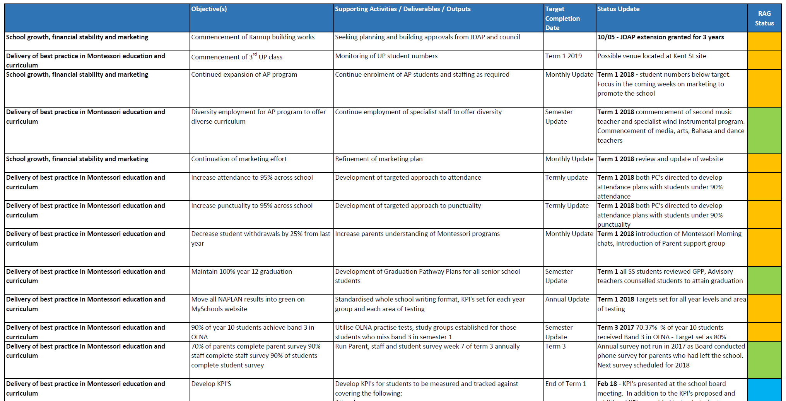
Board Update – Staff Surveys
Second year of Spacestation Limited surveys completed on Board and leadership team with RMS staff.
Identified need for additional communication of RMS strategy, as well as other improvement areas for the Board and leadership.

Slide 12
Board Update – Parent Surveys
Feedback positive around Learning Environment, teaching standards, values + culture, reporting and student / parent engagement.
Key improvement areas include Pastoral Care, Co-curriculum, leadership and direction and student transition.
Board responses to key improvement areas will be provided in next fortnight.

Slide 13
Board Update - Communication
Identified as a concern 2018 parent feedback (as well as 2017).
Regular Board updates being provided from Q1, 2018.

Slide 14
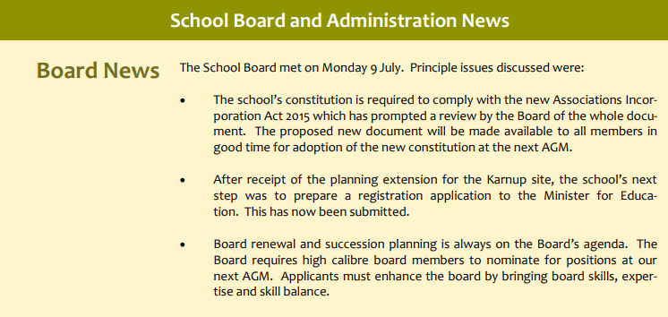
Board Update - Communication
Board updates and news on website

Slide 15
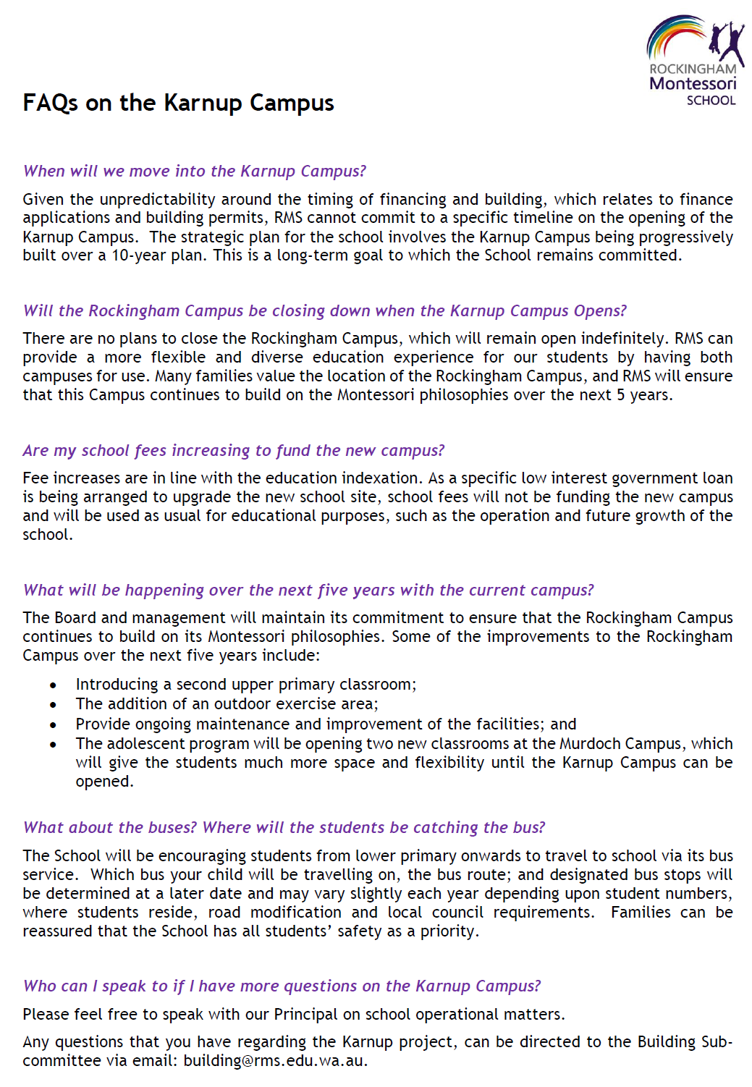
Board Update - Communication – FAQs

Slide 16
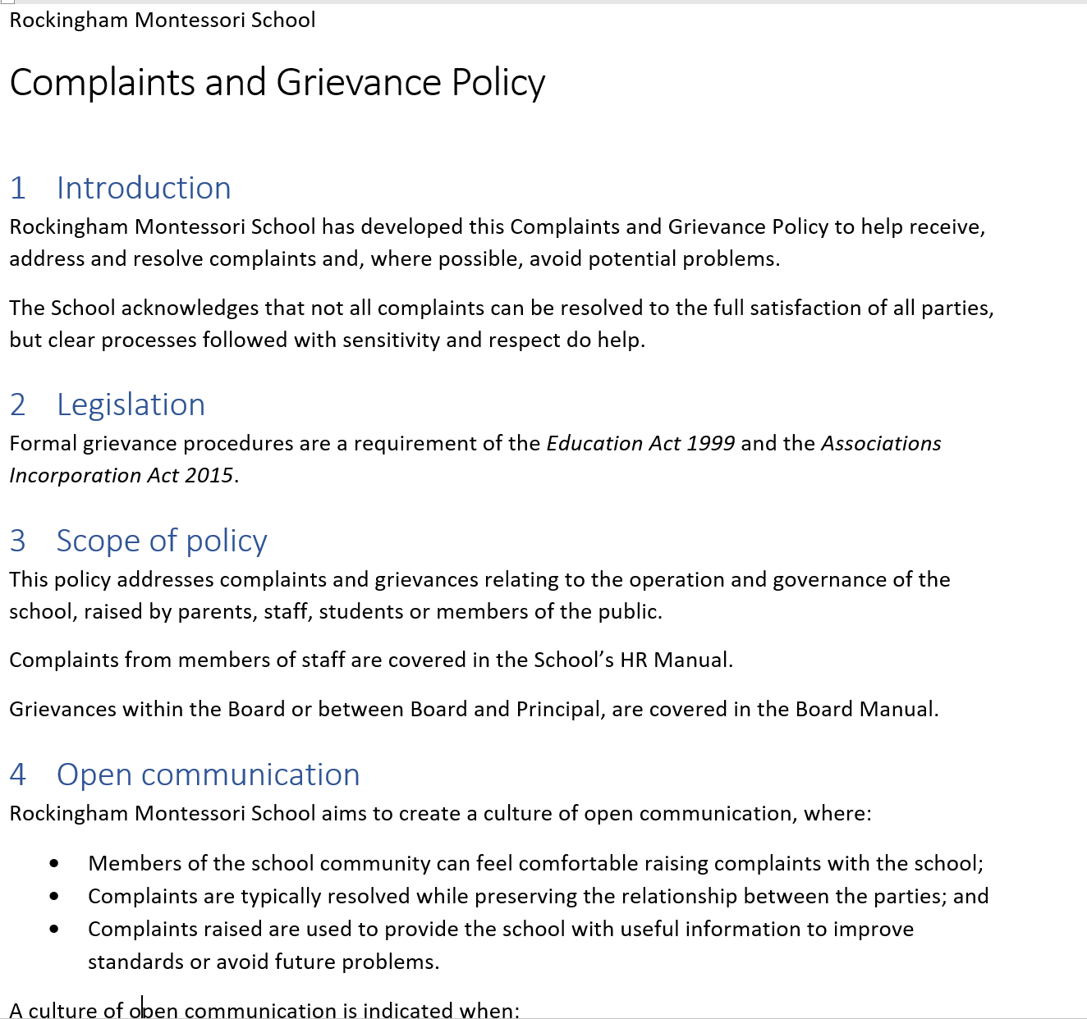
Board Update - Communication
Revised Grievance Policy can be initiated by either party to the grievance.
Includes escalation process – parents raise concerns with their teacher, Program Coordinator, Principal and Chair.
Chair may appoint committee to resolve matters raised. Board remains available to meet with parents individually, in accordance with revised Grievance Procedure.

Slide 17
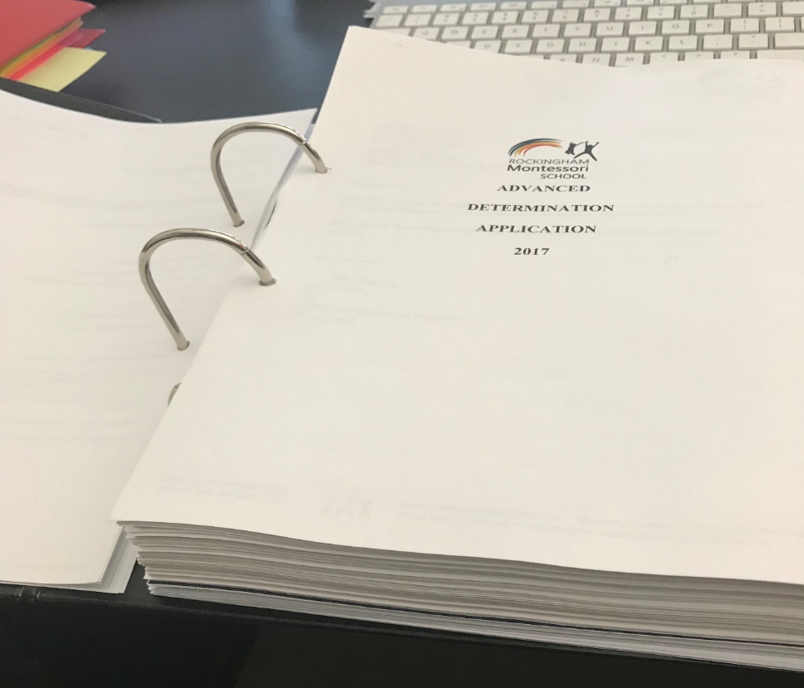
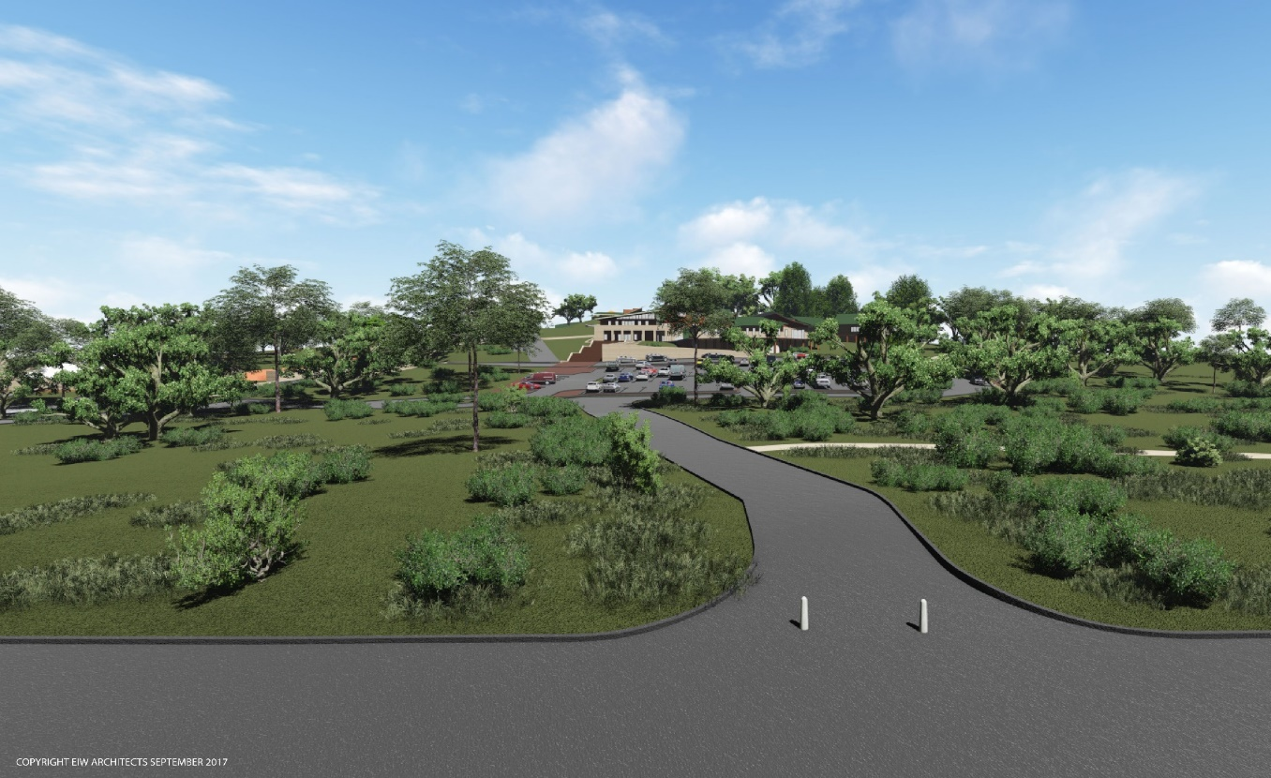
Board Update - Karnup
Continued efforts to move forward Karnup Approvals

Slide 18
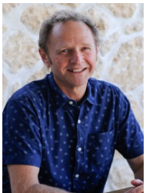
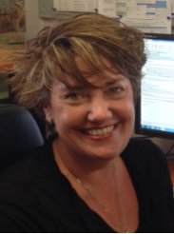
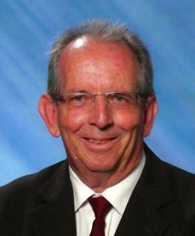
Board Update – Karnup
Building Sub-committee charged with coordinating Karnup Project
Nigel
Architect / Project Management Consultant
Vanessa
Principal
Neil
School Administration Consultant
Shea
Approvals, Enviro Consultant

Slide 19
Board Update – Karnup Process since Planning (JDAP) Approval (18/12/15)
Feb-16 - Registration and advanced determination of new school site applied for following JDAP approval, with numerous requests for supplementary information sought throughout year.
Jan-17 - Liberal government did not complete approval, and in January 2017 incoming Labor Government advised that ongoing applications were no longer on record.
Jul-17 - New advanced determination lodged in consultation with Labor government.
Apr-18 - JDAP extended for 2+ years.
May-18 - Advanced Determination received of the new school site.
Oct-18 – Registration approval for Karnup site by Director General.

Slide 20
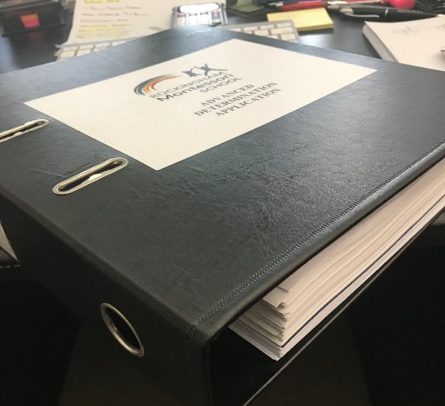
Board Update – Karnup Campus
The next steps for Karnup include:
1. Development Loans to finance the new school site.
2. Building Licence for Stage 1 works.
3. Studies initiated under coordination of Row Group.
These are all required before construction can commence.

Slide 21
Board Update – Karnup Campus
Revised Karnup site layout

Slide 22
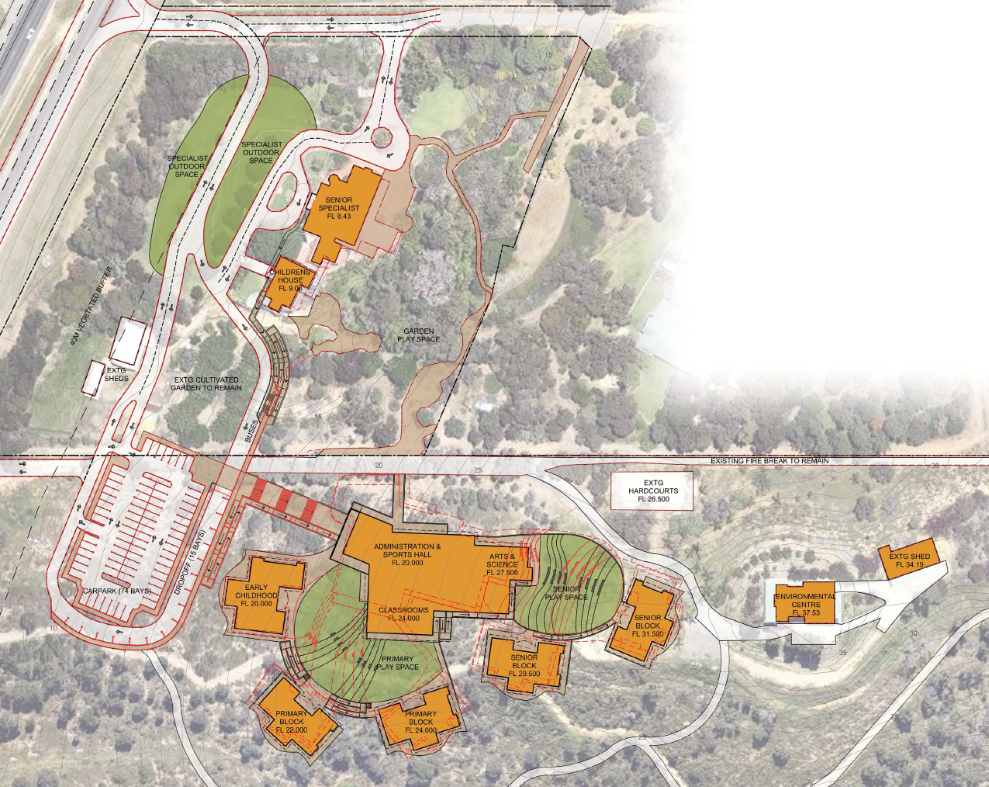
Board Update – Karnup Campus
Revised Karnup site layout
New pictures of the site
Changes based on changes to bushfire legislation and changes to EPBC legislation.

Slide 23
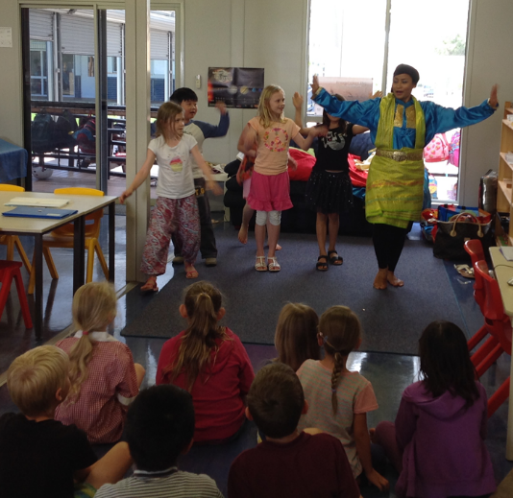
Questions or comments?

